Slide 1
StudySphere
AI Study Companion for School Students
Developed by Kaman Das

Slide 2
Brief About the Solution
StudySphere is an AI-powered learning platform that helps students understand difficult concepts, generate quizzes, create personalized study plans, and solve doubts instantly using Gemini AI.

Slide 3
Opportunities
a) Combines explanation, quiz generation, planning, and doubt solving in one platform.
b) Helps students learn faster and more effectively.
c) USP: Personalized AI-driven learning experience for school students.

Slide 4
Features
• AI Concept Explainer
• Instant Quiz Generator
• Personalized Study Planner
• AI Doubt Solver
• Gemini AI Powered Responses
• Clean Student-Friendly Interface

Slide 5
Process Flow Diagram
Student Input → Flask Backend → Gemini AI → Generated Response → Student Learning

Slide 6
Wireframes / Mockups
UI mockups and feature screens shown in following MVP snapshots.

Slide 7
Architecture Diagram
Frontend (HTML/CSS/JS)
↓
Flask Backend (Python)
↓
Gemini AI API
↓
Response Processing
↓
Frontend Display

Slide 8
Technologies Used
Frontend: HTML, CSS, JavaScript
Backend: Flask (Python)
AI: Google Gemini API
Deployment: GitHub Pages / Flask Hosting
Version Control: GitHub

Slide 9
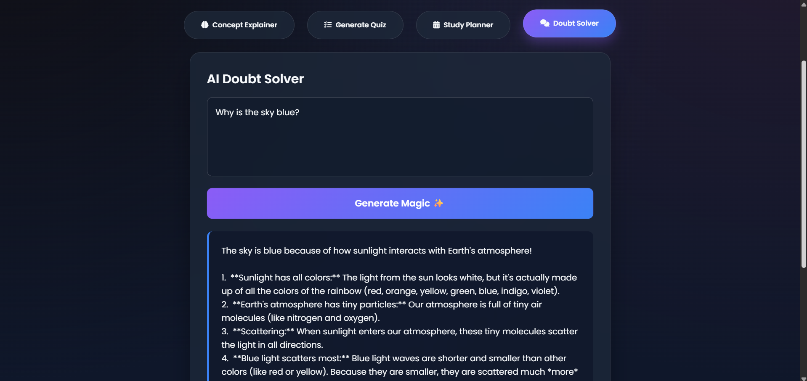
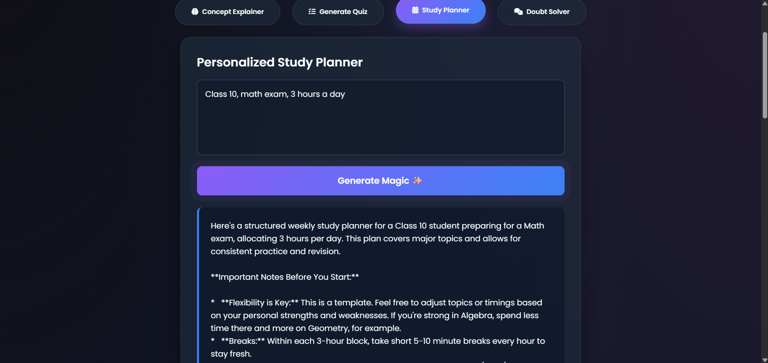
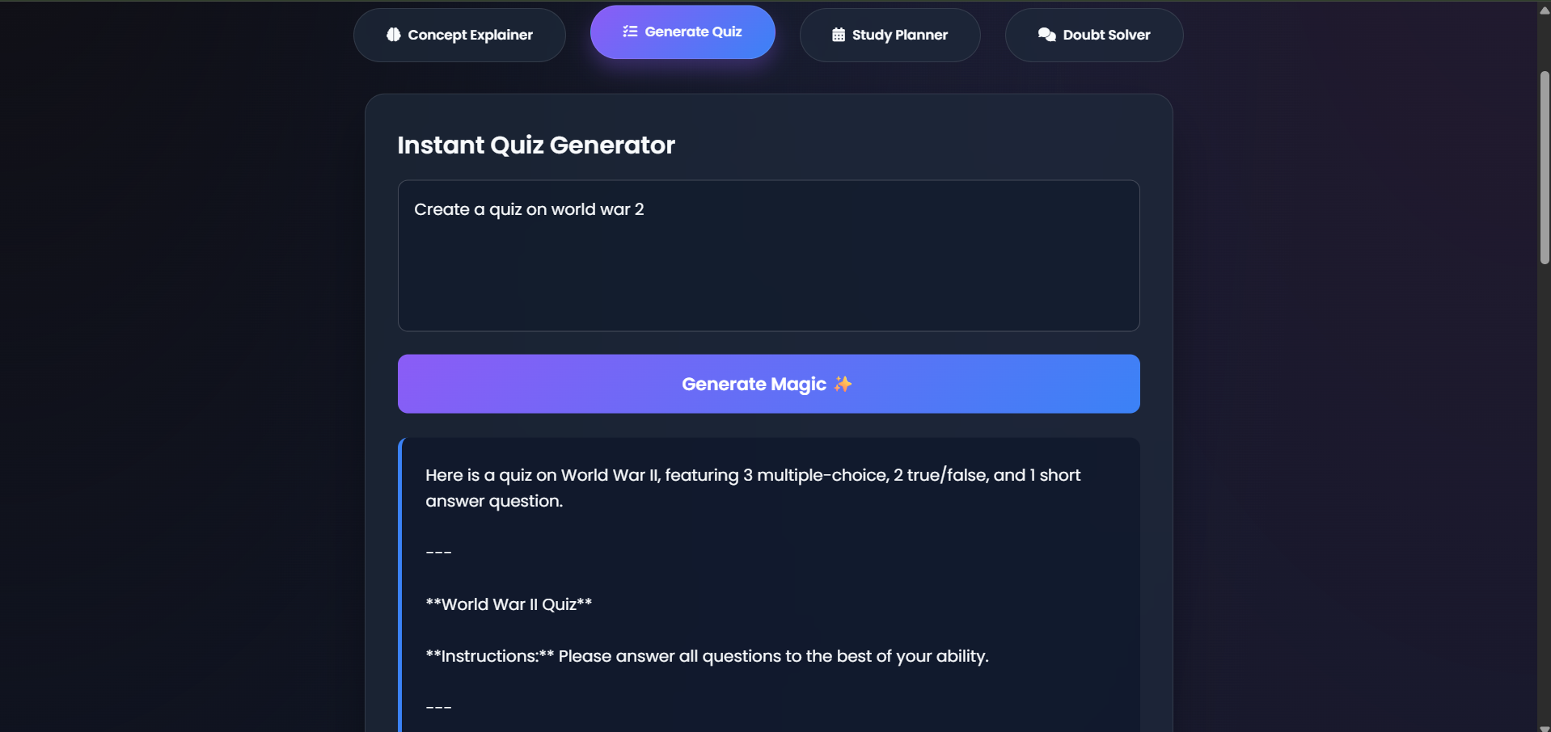
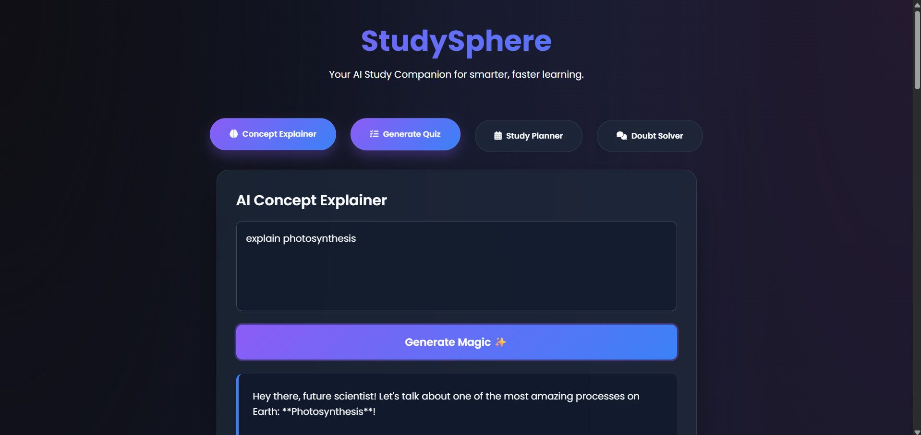
MVP Snapshots
shown on this slide.

Slide 10
Future Development
• User accounts
• Progress tracking
• Note upload and summarization
• Multi-language support
• Performance analytics dashboard

Slide 11
Project Links
GitHub Repository:
https://github.com/kamandas-108/StudySphere
Live Prototype:
https://kamandas-108.github.io/StudySphere/

Slide 12
Thank You
Thank you for your time and consideration.

